Slide 1


COMP3516: Data Analytics for IoT
Tutorial 2: Fourier Transform
Xinzhe Zheng
zhengxz@connect.hku.hk
Department of Computer Science

Slide 2
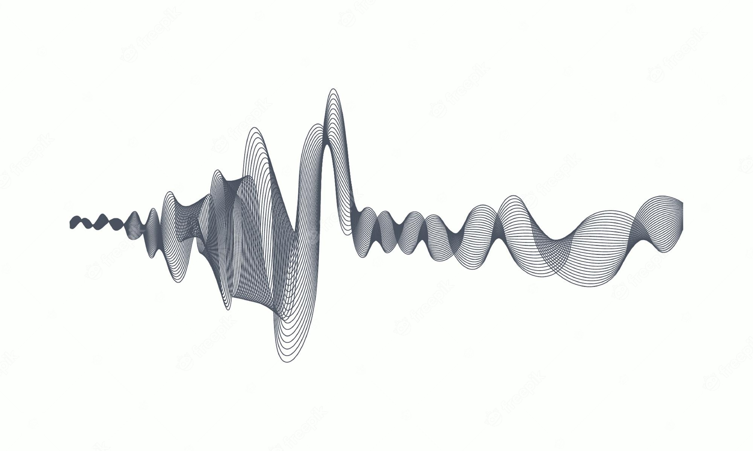
2. Fourier Transform
2.1 A different view
2.2 Properties of FFT
2.3 Applications
2.4 Breathing Detection

Slide 3
2. Fourier Transform
2.1 A Different View
As this lab is about the implementation or application of signal processing methods, we are not going to introduce these Fourier Transform algorithms too deep, but make you understand its fundamental ideas and how it can be used in our IoT data analysis.

Slide 4
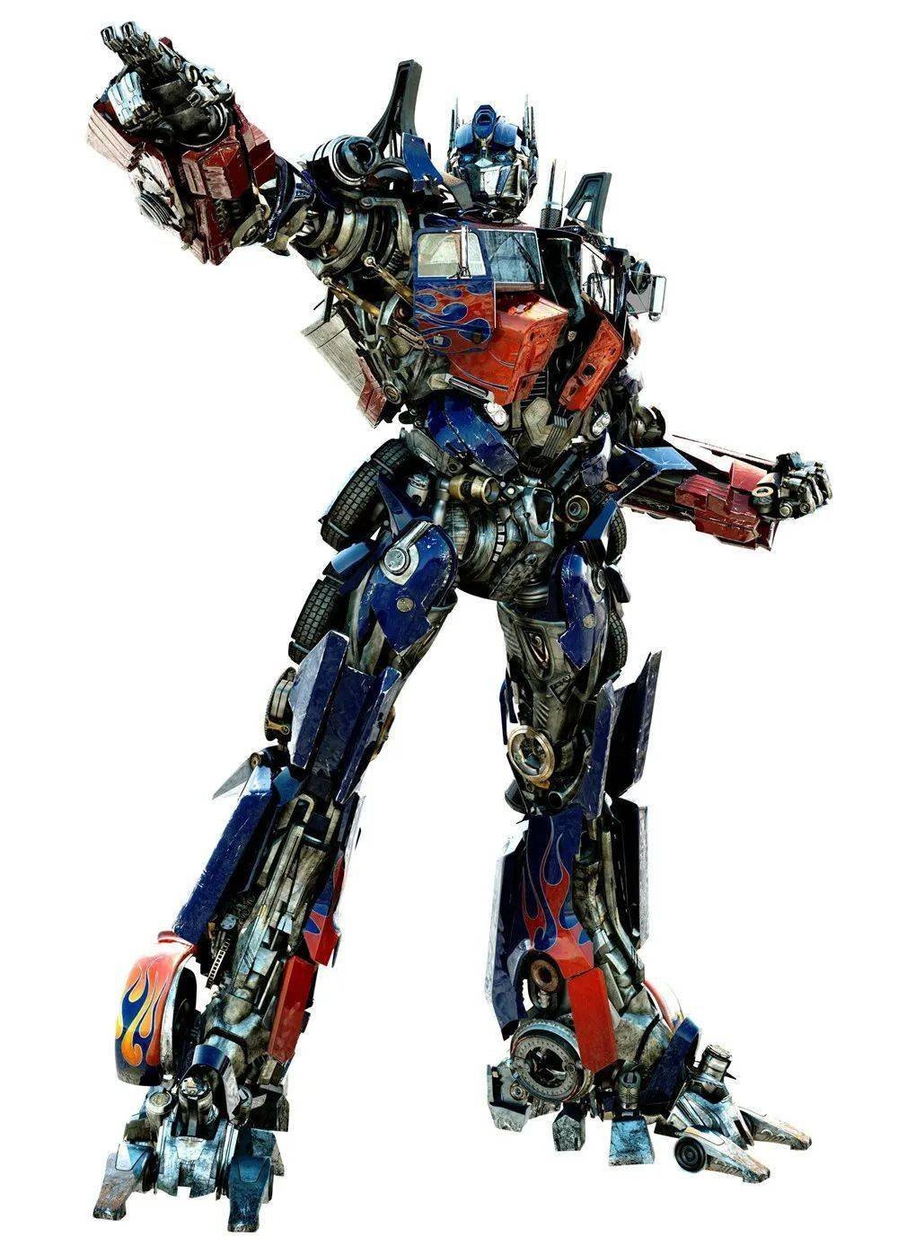
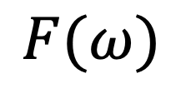
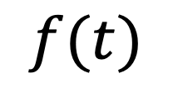
2. Fourier Transform
2.1 A Different View
Fourier Transform
What is Fourier?
What is Transform?
It’s just a name😂!
It’s a mapping between domains!
$$f(t)$$
$$F(ω)$$
Time Domain
Frequency Domain
The Fourier transform is reciprocal and unique

Slide 5
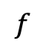
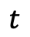
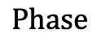
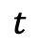
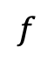
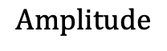
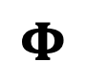
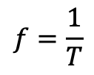

2. Fourier Transform
2.1 A Different View
Back in 18th century…
Time Domain
T
$$f=\frac{1}{T}$$
=
A
+
Other Sinusoids
$$t$$
$$t$$
𝛗
$$Amplitude$$
$$Phase$$
Frequency Domain
$$A$$
$$Φ$$
$$f$$
$$f$$

Slide 6
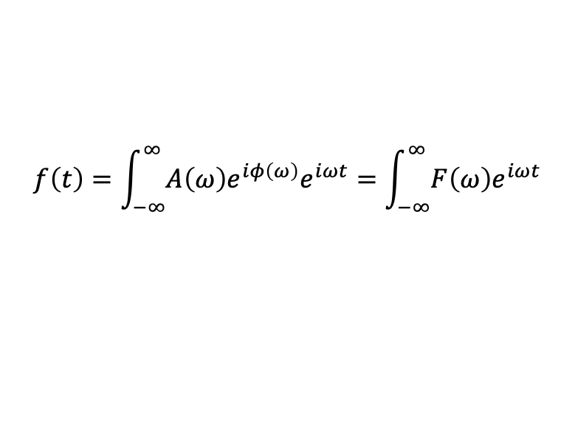
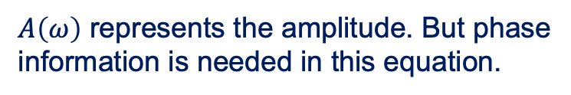
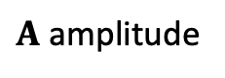
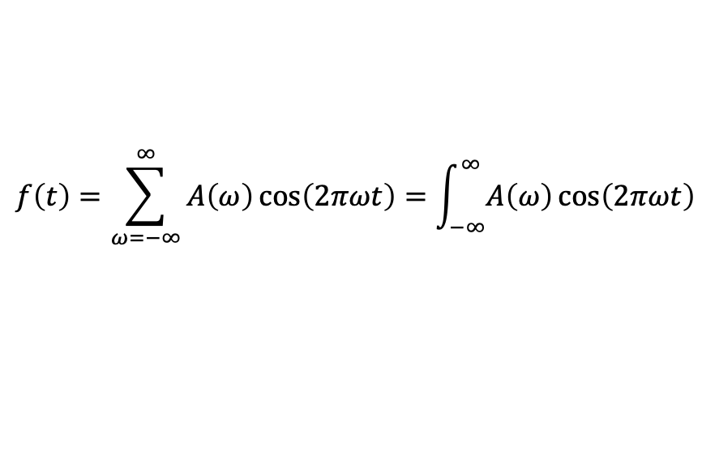
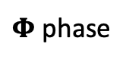
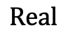
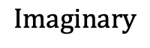
2. Fourier Transform
2.1 A Different View
More general…
$$f\left(t\right)=\sum_{ω=−∞}^{∞}{A\left(ω\right)\cos\left(2πωt\right)}=\int_{−∞}^{∞}{A\left(ω\right)\cos\left(2πωt\right)}$$
We can write:
$A\left(ω\right)$ represents the amplitude. But phase information is needed in this equation.
$$Imaginary$$
Based on Euler’s equation, we can use a complex number to present both amplitude and phase.
$A$ amplitude
$Φ$ phase
$$f\left(t\right)=\int_{−∞}^{∞}{A\left(ω\right)e^{iφ\left(ω\right)}e^{iωt}}=\int_{−∞}^{∞}{F\left(ω\right)e^{iωt}}$$
$$Real$$

Slide 7
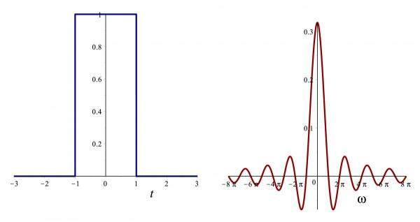
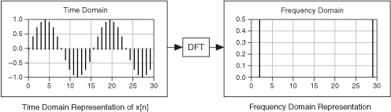
2. Fourier Transform
2.1 A Different View
The cases mentioned above is just the basic idea of Fourier Transform.
Actually, to get familiar with it, you need to start from Fourier Series…
Fourier Series
Continuous Fourier Transform
Discrete Fourier Transform
To be discovered in Lab02…

Slide 8
2. Fourier Transform
2.2 Properties of FFT
Fast Fourier Transform is a powerful tool that can calculate the Discrete Fourier Transform.
FFT can be much more faster than directly computing DFT by the formula.

Slide 9
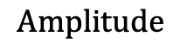
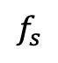
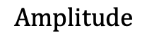
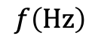
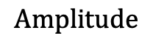
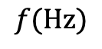
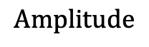
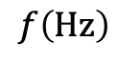
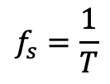
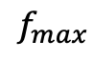
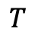
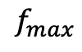
2. Fourier Transform
2.2 Properties of FFT
1. Sampling Rate
The signal you handle with is a discrete signal, which means you have to sample the analog signal with certain sampling frequency. So how to determine the sampling frequency?
$$Amplitude$$
1️⃣
$$Amplitude$$
2️⃣
$$T$$
3️⃣
$$Amplitude$$
$$f_{s}$$
$$t$$
$$f_{max}$$
$$f_{s}=\frac{1}{T}$$
$$Amplitude$$
$$f_{max}$$
$$f\left(Hz\right)$$
$$f(Hz)$$
Analog Signal
$$f\left(Hz\right)$$
Cannot Overlap

Slide 10
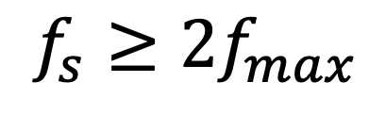
2. Fourier Transform
2.2 Properties of FFT
1. Sampling Rate
This is called the Nyquist Sampling Theory.
$$f_{s}≥2f_{max}$$

Slide 11
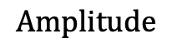
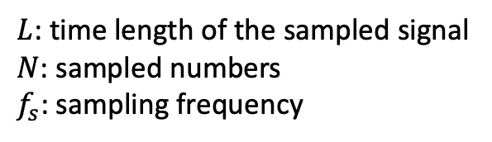
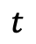
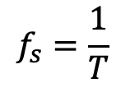
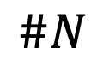
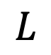
2. Fourier Transform
2.2 Properties of FFT
2. Frequency Resolution
$$Amplitude$$
$$L$$
……
$$\#N$$
$$f_{s}=\frac{1}{T}$$
$$t$$
$L$: time length of the sampled signal
$N$: sampled numbers
$f_{s}$: sampling frequency

Slide 12
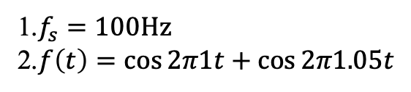
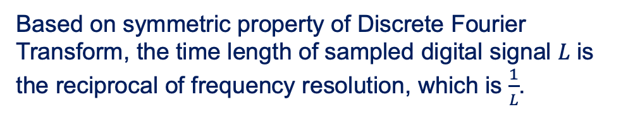

2. Fourier Transform
2.2 Properties of FFT
2. Frequency Resolution
Based on symmetric property of Discrete Fourier Transform, the time length of sampled digital signal $L$ is the reciprocal of frequency resolution, which is $\frac{1}{L}$.
1.$f_{s}=100Hz$
2.$f\left(t\right)=\cos{2π1t+\cos{2π1.05t}}$
EX1
$$∵\frac{1}{L}<0.05Hz$$
$$∴L>20s$$

Slide 13
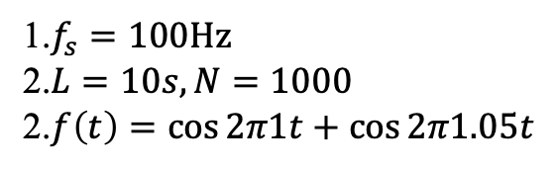

2. Fourier Transform
2.2 Properties of FFT
2. Frequency Resolution
Based on symmetric property of Discrete Fourier Transform, the time length of sampled digital signal $L$ is the reciprocal of frequency resolution, which is $\frac{1}{L}$.
EX1
1.$f_{s}=100Hz$
2.$L=10s, N=1000$
2.$f\left(t\right)=\cos{2π1t+\cos{2π1.05t}}$

Slide 14
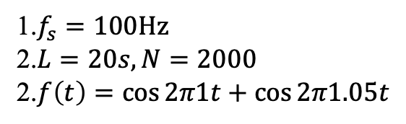
2. Fourier Transform
2.2 Properties of FFT
2. Frequency Resolution
Based on symmetric property of Discrete Fourier Transform, the time length of sampled digital signal $L$ is the reciprocal of frequency resolution, which is $\frac{1}{L}$.
EX1
1.$f_{s}=100Hz$
2.$L=20s, N=2000$
2.$f\left(t\right)=\cos{2π1t+\cos{2π1.05t}}$

Slide 15
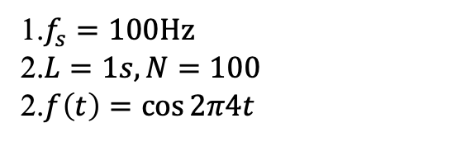
2. Fourier Transform
2.2 Properties of FFT
3. Zero-padding
Another important method is called zero-padding.
Due to some properties of time domain and frequency domain, increasing the length of the sequence is equivalent to interpolating in the frequency domain.
EX2
1.$f_{s}=100Hz$
2.$L=1s, N=100$
2.$f\left(t\right)=\cos{2π4t}$

Slide 16
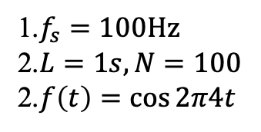
2. Fourier Transform
2.2 Properties of FFT
3. Zero-padding
EX2
1.$f_{s}=100Hz$
2.$L=1s, N=100$
2.$f\left(t\right)=\cos{2π4t}$
Zero-padding the sampled signal to the length of 128, 256, and 512.

Slide 17
2. Fourier Transform
2.2 Properties of FFT
3. Zero-padding
EX2
1.$f_{s}=100Hz$
2.$L=1s, N=100$
2.$f\left(t\right)=\cos{2π4t}$
Their corresponding DFT results.

Slide 18
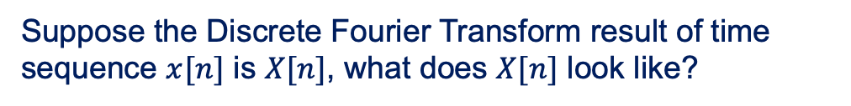
2. Fourier Transform
2.2 Properties of FFT
4. Amplitude and Phase
Suppose the Discrete Fourier Transform result of time sequence $x[n]$ is $X[n]$, what does $X[n]$ look like?
Frequency Domain
Amplitude
Frequency Domain
Phase
Time Domain
Even Symmetry
Odd Symmetry

Slide 19
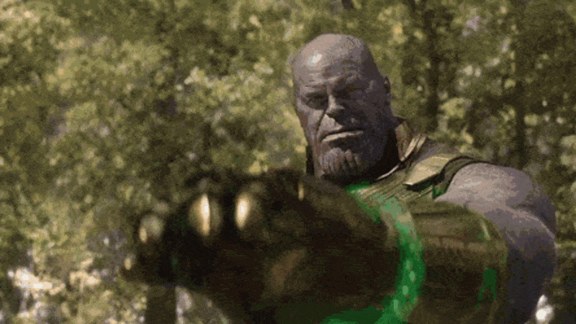
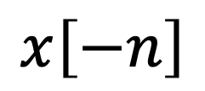
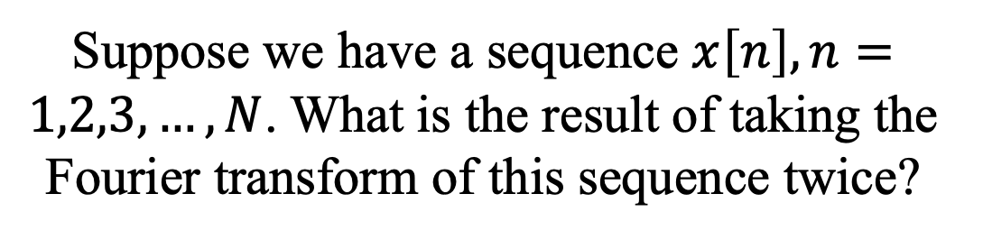
2. Fourier Transform
2.2 Properties of FFT
5. Interesting Question
EX3
Suppose we have a sequence $x\left[n\right], n=1,2,3,…,N$. What is the result of taking the Fourier transform of this sequence twice?
”Reversing Time"
$$x\left[−n\right]$$

Slide 20
2. Fourier Transform
2.3 Applications
Fourier Transform is one of the most important algorithm in our daily life.

Slide 21
2. Fourier Transform
2.4 Breathing Detection
In the last task in Lab02, you need to reconstruct the breathing rate of participants using Wi-Fi signals.
More details and background knowledge will be introduced in Prof. Wu’s lecture.

